Slide 1




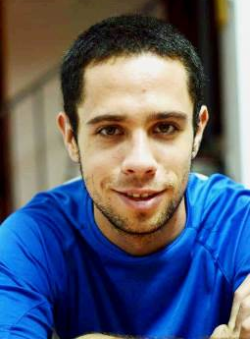
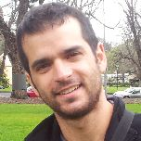
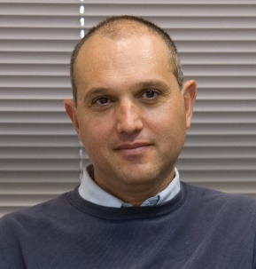

Signal Modeling:
From Convolutional Sparse Coding to Convolutional Neural Networks
Vardan Papyan
The Computer Science Department
Technion – Israel Institute of technology
Haifa 32000, Israel
Joint work with
Jeremias Sulam
Yaniv Romano
Prof. Michael Elad
The research leading to these results has been received funding from the European union's Seventh Framework Program (FP/2007-2013) ERC grant Agreement ERC-SPARSE- 320649

Slide 2
Motivation and Background
Part I

Slide 3
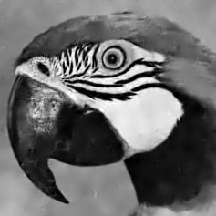

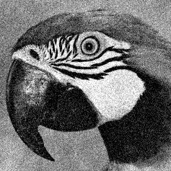






Our Starting Point: Image Denoising
Original Image
$$X$$
White Gaussian Noise
$$E$$
Noisy Image
$$Y$$
Many image denoising algorithms can be cast as the minimization of an energy function of the form
$$\frac{1}{2}{\left\|X−Y\right\|}_{2}^{2}$$
$$+$$
$$G(X)$$
Relation to
measurements
Prior or
regularization

Slide 4
Leading Image Denoising Methods…
are built upon powerful patch-based local models:
K-SVD: sparse representation modeling of image patches
[Elad & Aharon, ‘06]
BM3D: combines sparsity and self-similarity
[Dabov, Foi, Katkovnik & Egiazarian ‘07]
EPLL: uses GMM of the image patches
[Zoran & Weiss ‘11]
CSR: clustering and sparsity on patches
[Dong, Li, Lei & Shi ‘11]
MLP: multi-layer perceptron
[Burger, Schuler & Harmeling ‘12]
NCSR: non-local sparsity with centralized coefficients
[Dong, Zhang, Shi & Li ‘13]
WNNM: weighted nuclear norm of image patches
[Gu, Zhang, Zuo & Feng ‘14]
SSC–GSM: nonlocal sparsity with a GSM coefficient model
[Dong, Shi, Ma & Li ‘15]

Slide 5













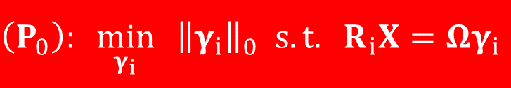




The Sparse-Land Model
Assumes every patch a linear combination of a few columns, called atoms, from a matrix that is termed a dictionary.
The operator $R_{i}$ extracts
the $i$-th $n$-dimensional patch
from $X∈ℝ^{N}$.
Sparse coding:
$$Ω$$
$$=$$
$$n$$
$$n$$
$$\left(P_{0}\right): \min_{γ_{i}}{ {\left\|γ_{i}\right\|}_{0} s.t. R_{i}X=Ωγ_{i}}$$
$$m>n$$
$$R_{i}X$$
$$N$$
$$R_{i}=$$
$$n$$
$$γ_{i}$$
$i$-th location
* $R_{i}$ for 1D signals

Slide 6




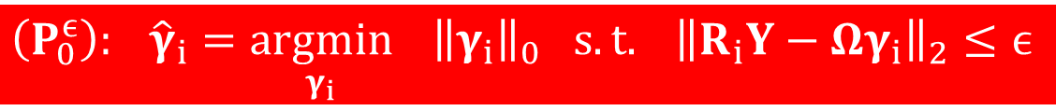
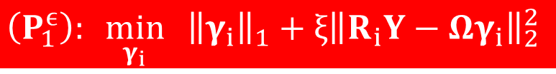

Patch Denoising
Given a noisy patch $R_{i}Y$, solve
$$\left(P_{0}^{ϵ}\right): {\hat{γ}}_{i}=\underset{γ_{i}}{argmin}{{ \left\|γ_{i}\right\|}_{0} s.t. {\left\|R_{i}Y−Ωγ_{i}\right\|}_{2}≤ϵ}$$
Clean patch: $Ω{\hat{γ}}_{i}$
$\left(P_{0}\right)$ and $(P_{0}^{ϵ})$ are hard to solve
Greedy methods such as Orthogonal Matching Pursuit (OMP) or Thresholding
Convex relaxations such as Basis Pursuit (BP)
$$\left(P_{1}^{ϵ}\right): \min_{γ_{i}}{ {\left\|γ_{i}\right\|}_{1}+ξ{\left\|R_{i}Y−Ωγ_{i}\right\|}_{2}^{2}}$$

Slide 7

Consider this Algorithm [Elad & Aharon, ‘06]
Noisy Image
Initial Dictionary
Using K-SVD
Reconstructed Image
Update the dictionary
Denoise each patch
Using OMP
$$\hat{X}=\underset{X,{\left\{γ_{i}\right\}}_{i},Ω}{argmin}{\frac{1}{2}{\left\|X−Y\right\|}_{2}^{2}+λ\sum_{i}{{\left\|γ_{i}\right\|}_{0}}+μ{\left\|R_{i}X−Ωγ_{i}\right\|}_{2}^{2}}$$
Relation to
measurements
Prior or regularization

Slide 8
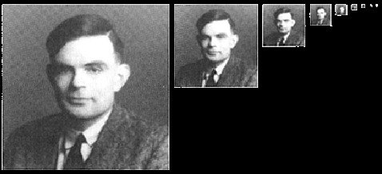

What is Missing?
Over the years, many researchers kept revisiting
this algorithm and the line of thinking behind it,
with a clear feeling that the final word has not
been said, and that key features are still lacking.
What is missing? Here is what our group thought of…
  A multi-scale treatment [Ophir, Lustig & Elad ‘11] [Sulam, Ophir & Elad ‘14] [Papyan & Elad ‘15]
  Exploiting self-similarities [Ram & Elad ‘13] [Romano, Protter & Elad ‘14]
  Pushing to better agreement on the overlaps [Romano & Elad ‘13] [Romano & Elad ‘15]
  Enforcing the local model on the final patches (EPLL) [Sulam & Elad ‘15]
Beyond all these, a key part that is missing is a theoretical backbone for the local model as a way to characterize the unknown image.
Beyond all these, a key part that is missing is a theoretical backbone for the local model as a way to characterize the global unknown image

Slide 9


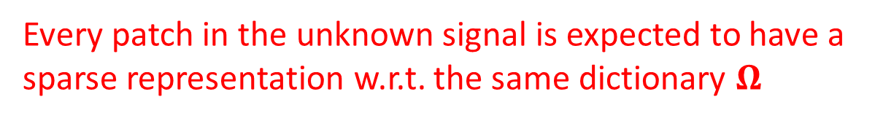
Missing Theoretical Backbone?
The core global-local model assumption on $X$:
Questions to consider:
  Who are those signals belonging to this model? Do they exist?
  Under which conditions on $Ω$ would this model be feasible?
  How does one sample from this model?
  How should we perform pursuit properly (and locally) under
  this model?
  How should we learn $Ω$ if this is indeed the model?
$$∀i R_{i}X=Ωγ_{i} where {\left\|γ_{i}\right\|}_{0}≤k$$
Every patch in the unknown signal is expected to have a sparse representation w.r.t. the same dictionary $Ω$

Slide 10
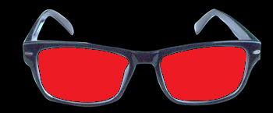
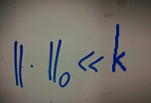
In this Talk
Limitations of patch averaging
Convolutional Sparse Coding (CSC) model
Multi-Layer Convolutional Sparse Coding (ML-CSC)
Theoretical study of CSC
Convolutional neural networks (CNN)
Fresh view of CNN through the eyes of sparsity

Slide 11

Convolutional
Sparse Coding
Part II
Working Locally Thinking Globally-Part $I$:
Theoretical Guarantees for Convolutional Sparse Coding
Working Locally Thinking Globally-Part $II$:
Stability and Algorithms for Convolutional Sparse Coding
Vardan Papyan, Jeremias Sulam and Michael Elad

Slide 12









Convolutional Sparsity Assumes…
$$X$$
$$=$$
$$+$$
$$+$$
$$+$$
$$+$$
$$+$$
$$+$$
$$+$$

Slide 13






Convolutional Sparse Representation
Formally, consider the following global sparsity-based model
$C^{i}∈ℝ^{N×N}$ is a banded and Circulant matrix containing a single atom with all of its shifts.
$Γ^{i}∈ℝ^{N}$ are its corresponding coefficients.
$$X=\sum_{i=1}^{m}{C^{i}Γ^{i}}$$
$$X=\sum_{i=1}^{m}{C^{i}Γ^{i}}=DΓ$$
$$n$$
$$C^{i}=$$
$$N$$

Slide 14





Two Interpretations
$$\left[C^{1} C^{2} C^{3}\right]=$$
$$D=$$

Slide 15

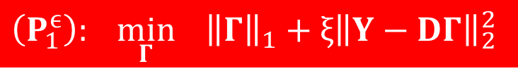
This model has been used in the past [Lewicki & Sejnowski ‘99]
[Hashimoto & Kurata, ‘00]
Most works have focused on solving efficiently its associated pursuit, called convolutional sparse coding, using the BP algorithm.
Several applications were demonstrated:
  Inpainting [Heide, Heidrich & Wetzstein ‘15]
  Super-resolution [Gu, Zuo, Xie, Meng, Feng & Zhang ‘15]
  Pattern detection in images and the analysis of instruments in music signals [Mørup, Schmidt & Hansen ’08]
However, little is known regrading its theoretical aspects.
$$\left(P_{1}^{ϵ}\right): \min_{Γ}{ {\left\|Γ\right\|}_{1}+ξ{\left\|Y−DΓ\right\|}_{2}^{2}}$$
Convolutional
dictionary

Slide 16
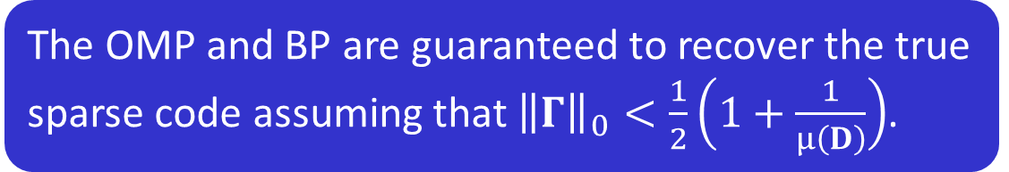
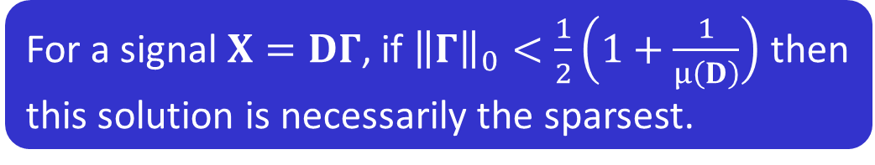

Classical Sparse Theory (Noiseless)
Mutual Coherence: $μ\left(D\right)=\max_{i≠j}{|d_{i}^{T}d_{j}|}$
[Donoho & Elad ‘03]
For a signal $X=DΓ$, if ${\left\|Γ\right\|}_{0}<\frac{1}{2}\left(1+\frac{1}{μ\left(D\right)}\right)$ then this solution is necessarily the sparsest.
[Donoho & Elad ‘03]
The OMP and BP are guaranteed to recover the true sparse code assuming that ${\left\|Γ\right\|}_{0}<\frac{1}{2}\left(1+\frac{1}{μ\left(D\right)}\right)$.
[Tropp ‘04]
[Donoho & Elad ‘03]

Slide 17

The Need for a Theoretical Study
Assuming that $m=2$ and $n=64$ we have that $μ(D)≥0.063$.
As a result, uniqueness and success of pursuits is guaranteed as
long as
$${\left\|Γ\right\|}_{0}<\frac{1}{2}\left(1+\frac{1}{μ(D)}\right)≤\frac{1}{2}\left(1+\frac{1}{0.063}\right)≈8$$
This is a very pessimistic result!
Less than 8 non-zeros GLOBALLY!!!

Slide 18











The Local Representation
$$(2n−1)m$$
$$(2n−1)m$$
$$R_{i}X$$
$$n$$
$$R_{i+1}X$$
=
$$n$$
$$γ_{i}$$
$$γ_{i+1}$$
stripe-dictionary
stripe vector
$$X=DΓ$$
Adjacent representations overlap, as they skip by $m$ items as we sweep through the patches of $X$
$$R_{i}X=Ωγ_{i}$$

Slide 19

Inherent Positive Properties
A clear global model with a shift invariant local prior.
  Every patch has a sparse representation w.r.t. to a local dictionary $Ω$.
No disagreement on the patch overlaps.
Related to the current common practice of patch averaging.
  The signal can be written as
  $$X=DΓ=\frac{1}{n}\sum_{i}{R_{i}^{T}Ωγ_{i}}$$
  $R_{i}^{T}$ puts the patch $Ωγ_{i}$ in the $i$-th location in the $N$-dimensional vector.
  The patch averaging scheme solves the sparse coding problem independently for every patch while convolutional sparse coding seeks for the representations of all the patches together.

Slide 20
















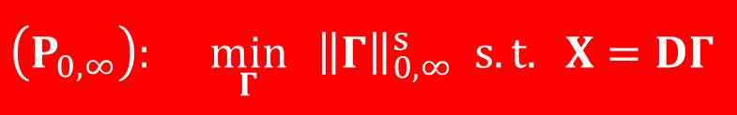














The $ℓ_{0,∞}$ Norm and the $P_{0,∞}$ Problem
$$m=2$$
$$γ_{i}$$
The Main Questions We Aim to Address:
Uniqueness of the solution to this problem ?
Guaranteed recovery of the solution via global OMP/BP ?
$${\left\|Γ\right\|}_{0,∞}^{s}=\max_{i} {\left\|γ_{i}\right\|}_{0}$$
$$γ_{i}$$
$$γ_{i}$$
$$γ_{i}$$
$$γ_{i}$$
$$γ_{i}$$
$$γ_{i}$$
$$\left(P_{0,∞}\right): \min_{Γ}{{ \left\|Γ\right\|}_{0,∞}^{s} s.t. X=DΓ}$$
$$γ_{i}$$
$$γ_{i}$$
$$γ_{i}$$
$$γ_{i}$$
$$γ_{i}$$
A global sparse vector is likely if it can represent every patch in the signal sparsely.
$$γ_{i}$$
$$γ_{i}$$
$$γ_{i}$$
$$γ_{i}$$
$$γ_{i}$$
$$γ_{i}$$
$$γ_{i}$$
$$γ_{i}$$
$$γ_{i}$$
$$γ_{i}$$
$$γ_{i}$$
$$γ_{i}$$
$$γ_{i}$$
$$γ_{i}$$
$$γ_{i}$$

Slide 21
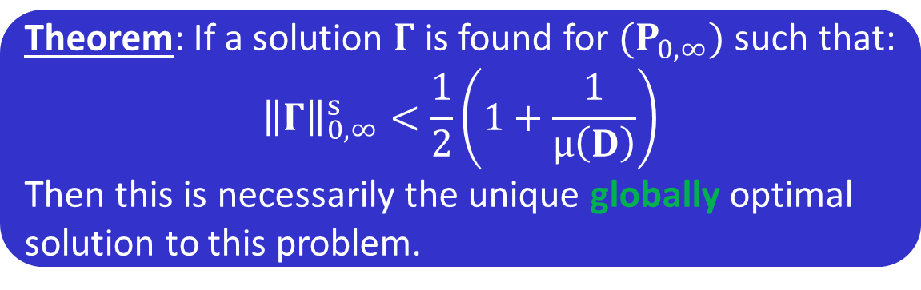


Uniqueness via Mutual Coherence
$$\left(P_{0,∞}\right): \min_{Γ}{{ \left\|Γ\right\|}_{0,∞}^{s} s.t. X=DΓ}$$
Theorem: If a solution $Γ$ is found for $(P_{0,∞})$ such that:
$${\left\|Γ\right\|}_{0,∞}^{s}<\frac{1}{2}\left(1+\frac{1}{μ\left(D\right)}\right)$$
Then this is necessarily the unique globally optimal solution to this problem.
We should be excited about this result and later ones because they pose a local constraint for a global guarantee, and as such, they are far more optimistic compared to the global guarantees
8 non-zeros per stripe can result in $0.06⋅N$ non-zeros globally

Slide 22


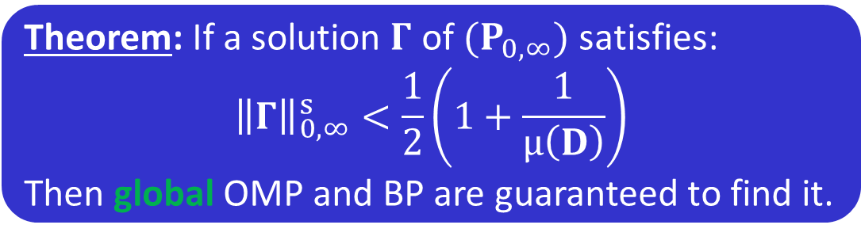
Recovery Guarantees
$$\left(P_{0,∞}\right): \min_{Γ}{{ \left\|Γ\right\|}_{0,∞}^{s} s.t. X=DΓ}$$
Lets solve this problem via OMP or BP, applied globally
Theorem: If a solution $Γ$ of $(P_{0,∞})$ satisfies:
$${\left\|Γ\right\|}_{0,∞}^{s}<\frac{1}{2}\left(1+\frac{1}{μ\left(D\right)}\right)$$
Then global OMP and BP are guaranteed to find it.
Both OMP and BP do not assume local sparsity but still succeed. One could propose algorithms that rely on this assumption

Slide 23
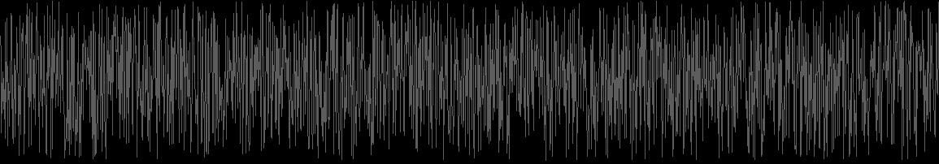


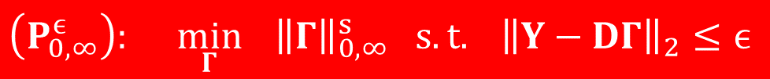
From Ideal to Noisy Signals
So far, we have assumed an ideal signal $X=DΓ$.
However, in practice we usually have $Y=DΓ+E$ where $E$ is due to noise or model deviations.
To handle this, we redefine our problem as:
The Main Questions We Aim to Address:
  Stability of the solution to this problem ?
  Stability of the solution obtained via global OMP/BP ?
  The same recovery done via local operations ?
$$\left(P_{0,∞}^{ϵ}\right): \min_{Γ}{{ \left\|Γ\right\|}_{0,∞}^{s} s.t. {\left\|Y−DΓ\right\|}_{2}≤ϵ}$$

Slide 24

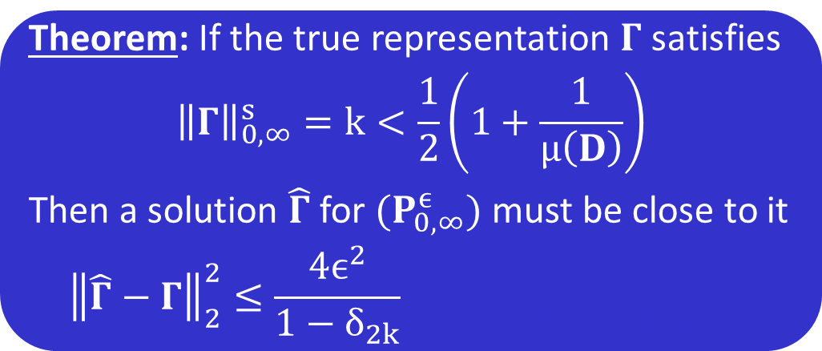


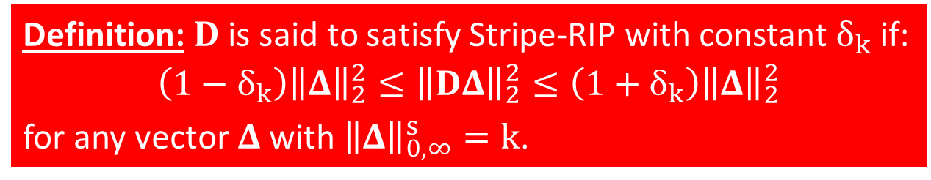


Stability of $\left(P_{0,∞}^{ϵ}\right)$ via Stripe-RIP
[Candes & Tao ‘05]
$$\left(P_{0,∞}^{ϵ}\right): \min_{Γ}{{ \left\|Γ\right\|}_{0,∞}^{s} s.t. {\left\|Y−DΓ\right\|}_{2}≤ϵ}$$
$$\hat{Γ}$$
Definition: $D$ is said to satisfy Stripe-RIP with constant $δ_{k}$ if:
$$\left(1−δ_{k}\right){\left\|Δ\right\|}_{2}^{2}≤{\left\|DΔ\right\|}_{2}^{2}≤\left(1+δ_{k}\right){\left\|Δ\right\|}_{2}^{2}$$
for any vector $Δ$ with ${\left\|Δ\right\|}_{0,∞}^{s}=k$.
Theorem: If the true representation $Γ$ satisfies
$${\left\|Γ\right\|}_{0,∞}^{s}=k<\frac{1}{2}\left(1+\frac{1}{μ\left(D\right)}\right)$$
Then a solution $\hat{Γ}$ for $(P_{0,∞}^{ϵ})$ must be close to it
$${\left\|\hat{Γ}−Γ\right\|}_{2}^{2}≤\frac{4ϵ^{2}}{1−δ_{2k}}≤\frac{4ϵ^{2}}{1−\left(2k−1\right)μ\left(D\right)}$$
$$≤\frac{4ϵ^{2}}{1−\left(2k−1\right)μ\left(D\right)}$$
$$δ_{k}≤(k−1)μ(D)$$

Slide 25


Local Noise Assumption
Thus far, our analysis relied on the local sparsity of the underlying solution $Γ$, which was enforced through the $ℓ_{0,∞}$ norm.
In what follows, we present stability guarantees for both OMP and BP that will also depend on the local energy in the noise vector $E$.
This will be enforced via the $ℓ_{2,∞}$ norm, defined as:
$${\left\|E\right\|}_{2,∞}^{p}=\max_{i} {\left\|R_{i}E\right\|}_{2}$$

Slide 26

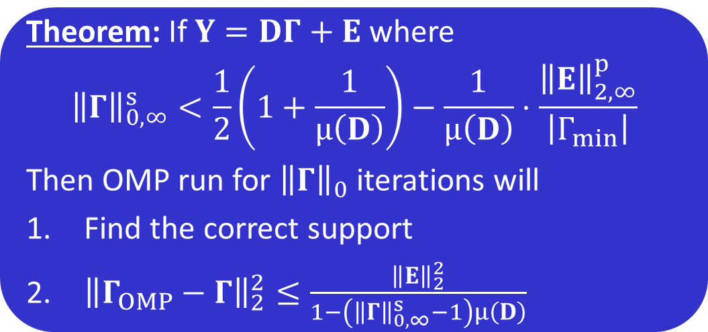
Stability of OMP
Theorem: If $Y=DΓ+E$ where
$${\left\|Γ\right\|}_{0,∞}^{s}<\frac{1}{2}\left(1+\frac{1}{μ\left(D\right)}\right)−\frac{1}{μ\left(D\right)}⋅\frac{{\left\|E\right\|}_{2,∞}^{p}}{\left|Γ_{min}\right|}$$
Then OMP run for ${\left\|Γ\right\|}_{0}$ iterations will
Find the correct support
${\left\|Γ_{OMP}−Γ\right\|}_{2}^{2}≤\frac{{\left\|E\right\|}_{2}^{2}}{1−\left({\left\|Γ\right\|}_{0,∞}^{s}−1\right)μ\left(D\right)}$

Slide 27


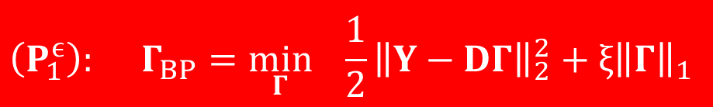
Stability of Lagrangian BP
$$\left(P_{1}^{ϵ}\right): Γ_{BP}=\min_{Γ}{ \frac{1}{2}{\left\|Y−DΓ\right\|}_{2}^{2}+ξ{\left\|Γ\right\|}_{1}}$$
Theorem: For $Y=DΓ+E$, if $ξ=4{\left\|E\right\|}_{2,∞}^{p}$ and
$${\left\|Γ\right\|}_{0,∞}^{s}<\frac{1}{3}\left(1+\frac{1}{μ\left(D\right)}\right)$$
Then we are guaranteed that
The support of $Γ_{BP}$ is contained in that of $Γ$
${\left\|Γ_{BP}−Γ\right\|}_{∞}≤7.5{\left\|E\right\|}_{2,∞}^{p}$
Every entry greater than $7.5{\left\|E\right\|}_{2,∞}^{p}$ will be found
$Γ_{BP}$ is unique.
Theoretical foundation for recent works tackling the convolutional sparse coding problem via BP
[Bristow, Eriksson & Lucey ‘13]
[Wohlberg ‘14]
[Kong & Fowlkes ‘14]
[Bristow & Lucey ‘14]
[Heide, Heidrich & Wetzstein ‘15]
[Šorel & Šroubek ‘16]
Proof relies on the work of [Tropp ‘06]

Slide 28
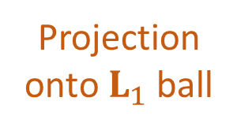





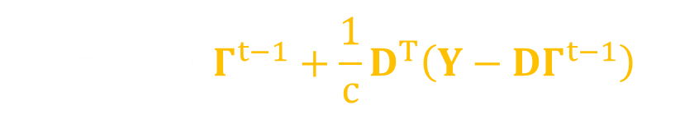
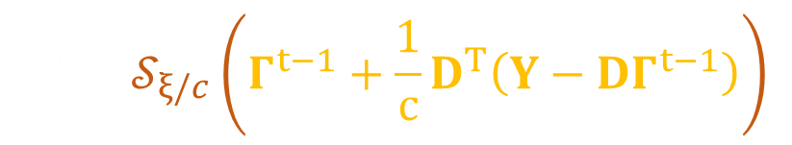

Global Pursuit via Local Processing
$$\left(P_{1}^{ϵ}\right): Γ_{BP}=\min_{Γ}{ \frac{1}{2}{\left\|Y−DΓ\right\|}_{2}^{2}+ξ{\left\|Γ\right\|}_{1}}$$
Thus far, we have seen that while the CSC is a global model, its theoretical guarantees rely on local properties. Yet this global-local relation can also be exploited for practical purposes. Next, we show how one can solve the global BP problem using only local operations.
Iterative Soft Thresholding [Blumensath & Davies ‘08]:
This can be equally written as:
$$∀i α_{i}^{t}=𝒮_{ξ/c}\left(α_{i}^{t−1}+D_{L}^{T} R_{i}(Y−DΓ^{t−1})\right)$$
$$Γ^{t}=𝒮_{ξ/c}\left(Γ^{t−1}+\frac{1}{c}D^{T}\left(Y−DΓ^{t−1}\right)\right)$$
$$Γ$$
$$Γ^{t}=𝒮_{ξ/c}\left(Γ^{t−1}+\frac{1}{c}D^{T}\left(Y−DΓ^{t−1}\right)\right)$$
$$Γ^{t}=𝒮_{ξ/c}\left(Γ^{t−1}+\frac{1}{c}D^{T}\left(Y−DΓ^{t−1}\right)\right)$$
Projection onto $L_{1}$ ball
$$α_{i}$$
Gradient step
global aggregation
$$⋮$$
local sparse code
local dictionary
local residual
* $c>0.5 λ_{max}(D^{T}D)$

Slide 29
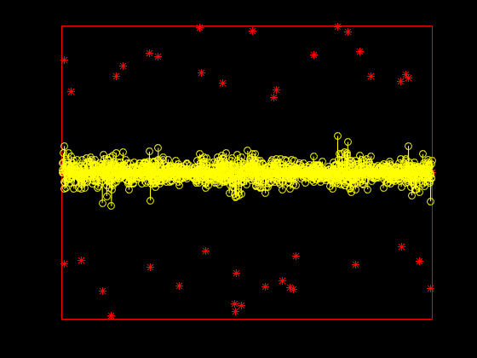


Simulation
Details:
Signal length: $N = 300$
Patch size: $n = 25$
Unique atoms: $p = 5$
Global sparsity: $k = 40$
Number of iterations: $400$
Lagrangian: $ξ=4{\left\|E\right\|}_{2,∞}^{p}$

Slide 30



Partial Summary of CSC
What we have seen so far is a new way to analyze the global CSC model using local sparsity constrains. We proved:
  Uniqueness of the solution to the noiseless problem.
  Stability of the solution to the noisy problem.
  Guarantee of success and stability of both OMP and BP.
We obtained guarantees and algorithms that operate locally while claiming global optimality.

Slide 31
Going Deeper
Part III
Convolutional Neural Networks Analyzed via
Convolutional Sparse Coding
Vardan Papyan, Yaniv Romano and Michael Elad

Slide 32
CSC and CNN
There seems to be a relation between CSC and CNN:
  Both have a convolutional structure.
  Both use a data driven approach for training their model.
  The most popular non-linearity employed in CNN, called ReLU, is known to be connected to sparsity.
In this part, we aim to make this connection clear in order to provide a theoretical understanding of CNN through the eyes of sparsity.
But first, a short review of CNN…

Slide 33
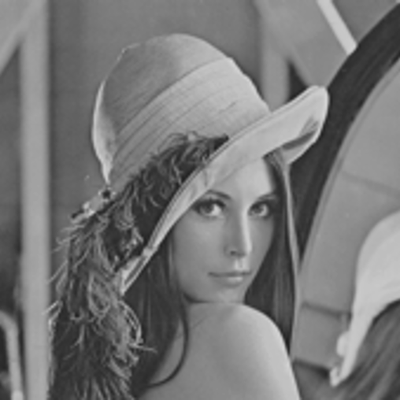


CNN
$$X$$
ReLU
ReLU
[LeCun, Bottou, Bengio and Haffner ‘98]
[Krizhevsky, Sutskever & Hinton ‘12]
[Simonyan & Zisserman ‘14]
[He, Zhang, Ren & Sun ‘15]
$$ReLU\left(z\right)=\max\left(0,z\right)$$

Slide 34















CNN
$$X$$
$$m_{1}$$
$$m_{2}$$
$$\sqrt{N}$$
$$\sqrt{N}$$
$$\sqrt{N}$$
$$\sqrt{n_{1}}$$
$$W_{2}$$
$$\sqrt{N}$$
$$\sqrt{N}$$
$$\sqrt{N}$$
$$\sqrt{n_{1}}$$
$$\sqrt{n_{0}}$$
$$W_{1}$$
$$\sqrt{n_{0}}$$
No pooling stage:
Can be replaced by a convolutional layer with increased stride without loss in performance [Springenberg, Dosovitskiy, Brox & Riedmiller ‘14]
The current state-of-the-art in image recognition does not use it
[He, Zhang, Ren & Sun ‘15]

Slide 35













Mathematically...
$$f\left(X,\left\{W_{i}\right\},\left\{b_{i}\right\}\right)=ReLU\left(b_{2}+W_{2}^{T} ReLU\left(b_{1}+W_{1}^{T}X\right)\right)$$
$$f\left(X,\left\{W_{i}\right\},\left\{b_{i}\right\}\right)=ReLU\left(b_{2}+W_{2}^{T} ReLU\left(b_{1}+W_{1}^{T}X\right)\right)$$
$$f\left(X,\left\{W_{i}\right\},\left\{b_{i}\right\}\right)=ReLU\left(b_{2}+W_{2}^{T} ReLU\left(b_{1}+W_{1}^{T}X\right)\right)$$
$$f\left(X,\left\{W_{i}\right\},\left\{b_{i}\right\}\right)=ReLU\left(b_{2}+W_{2}^{T} ReLU\left(b_{1}+W_{1}^{T}X\right)\right)$$
$$f\left(X,\left\{W_{i}\right\},\left\{b_{i}\right\}\right)=ReLU\left(b_{2}+W_{2}^{T} ReLU\left(b_{1}+W_{1}^{T}X\right)\right)$$
$$f\left(X,\left\{W_{i}\right\},\left\{b_{i}\right\}\right)=ReLU\left(b_{2}+W_{2}^{T} ReLU\left(b_{1}+W_{1}^{T}X\right)\right)$$
$$f\left(X,\left\{W_{i}\right\},\left\{b_{i}\right\}\right)=ReLU\left(b_{2}+W_{2}^{T} ReLU\left(b_{1}+W_{1}^{T}X\right)\right)$$
$$f\left(X,\left\{W_{i}\right\},\left\{b_{i}\right\}\right)=ReLU\left(b_{2}+W_{2}^{T} ReLU\left(b_{1}+W_{1}^{T}X\right)\right)$$
$$Z_{2}∈ℝ^{Nm_{2}}$$
$$b_{2}∈ℝ^{Nm_{2}}$$
$$W_{2}^{T}∈ℝ^{Nm_{2}×Nm_{1}}$$
$$n_{1}m_{1}$$
$$b_{1}∈ℝ^{Nm_{1}}$$
$$W_{1}^{T}∈ℝ^{Nm_{1}×N}$$
$$m_{2}$$
$$n_{0}$$
$$m_{1}$$
$$X∈ℝ^{N}$$
$$ReLU$$
$$ReLU$$
$$m_{1}$$

Slide 36
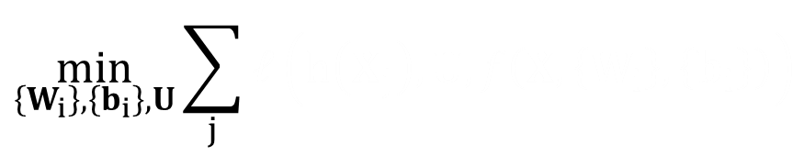


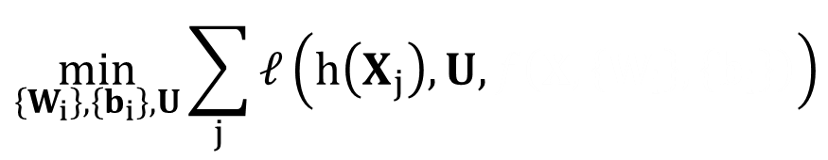
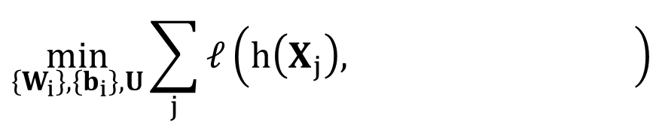
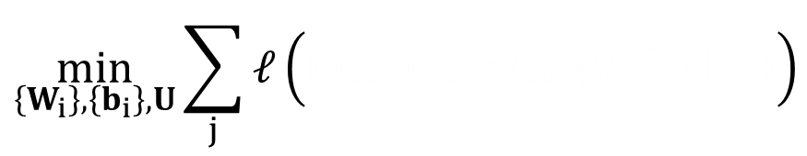
Training Stage of CNN
Consider the task of classification, for example.
Given a set of signals ${\left\{X_{j}\right\}}_{j}$ and their corresponding labels ${\left\{h\left(X_{j}\right)\right\}}_{j}$, the CNN learns an end-to-end mapping.
$$\min_{\left\{W_{i}\right\},\left\{b_{i}\right\},U}{\sum_{j}{ℓ\left(h\left(X_{j}\right),U,f\left(X,\left\{W_{i}\right\},\left\{b_{i}\right\}\right)\right)}}$$
$$\min_{\left\{W_{i}\right\},\left\{b_{i}\right\},U}{\sum_{j}{ℓ\left(h\left(X_{j}\right),U,f\left(X,\left\{W_{i}\right\},\left\{b_{i}\right\}\right)\right)}}$$
$$\min_{\left\{W_{i}\right\},\left\{b_{i}\right\},U}{\sum_{j}{ℓ\left(h\left(X_{j}\right),U,f\left(X,\left\{W_{i}\right\},\left\{b_{i}\right\}\right)\right)}}$$
$$\min_{\left\{W_{i}\right\},\left\{b_{i}\right\},U}{\sum_{j}{ℓ\left(h\left(X_{j}\right),U,f\left(X,\left\{W_{i}\right\},\left\{b_{i}\right\}\right)\right)}}$$
$$\min_{\left\{W_{i}\right\},\left\{b_{i}\right\},U}{\sum_{j}{ℓ\left(h\left(X_{j}\right),U,f\left(X,\left\{W_{i}\right\},\left\{b_{i}\right\}\right)\right)}}$$
True label
Classifier
Output of last layer

Slide 37











Back to CSC
$$X∈ℝ^{N}$$
$$D_{1}∈ℝ^{N×Nm_{1}}$$
$$Γ_{1}∈ℝ^{Nm_{1}}$$
Similarly, the representations themselves could also be assumed to have such a structure.
$$m_{1}$$
$$n_{0}$$
$$Γ_{1}∈ℝ^{Nm_{1}}$$
$$D_{2}∈ℝ^{Nm_{1}×Nm_{2}}$$
$$Γ_{2}∈ℝ^{Nm_{2}}$$
$$m_{2}$$
$$n_{1}m_{1}$$
Convolutional sparsity assumes an inherent structure is present in natural signals.
$$m_{1}$$
Multi-Layer CSC (ML-CSC)

Slide 38
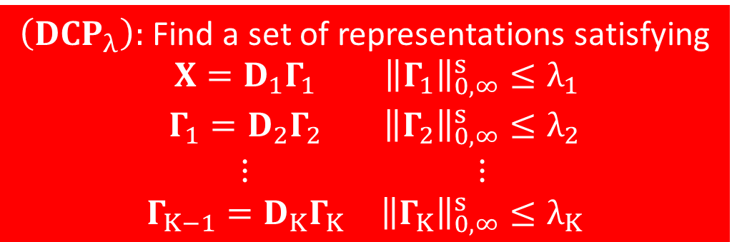
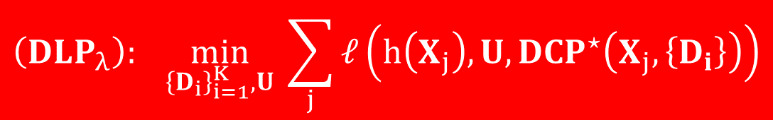
Deep Coding and Learning Problems
$\left(DCP_{λ}\right):$ Find a set of representations satisfying
$$\begin{matrix}X=D_{1}Γ_{1} & {\left\|Γ_{1}\right\|}_{0,∞}^{s}≤λ_{1} \\ Γ_{1}=D_{2}Γ_{2} & {\left\|Γ_{2}\right\|}_{0,∞}^{s}≤λ_{2} \\ ⋮ & ⋮ \\ Γ_{K−1}=D_{K}Γ_{K} & {\left\|Γ_{K}\right\|}_{0,∞}^{s}≤λ_{K}\end{matrix}$$
$$\left(DLP_{λ}\right): \min_{{\left\{D_{i}\right\}}_{i=1}^{K},U}{ \sum_{j}{ℓ\left(h\left(X_{j}\right),U,{DCP}^{⋆}\left(X_{j},\left\{D_{i}\right\}\right)\right)}}$$
True label
Classifier
Deepest representation obtained by solving the DCP
Task driven dictionary learning
[Mairal, Bach & Ponce ‘12]

Slide 39
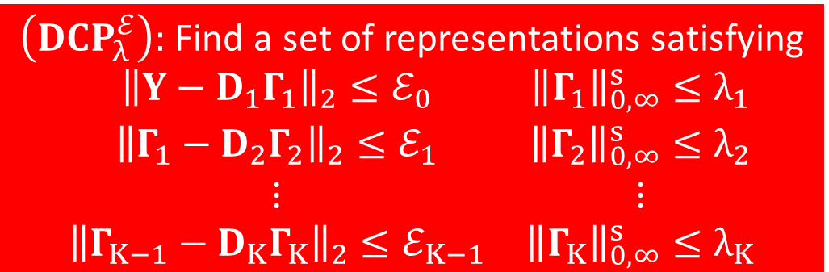
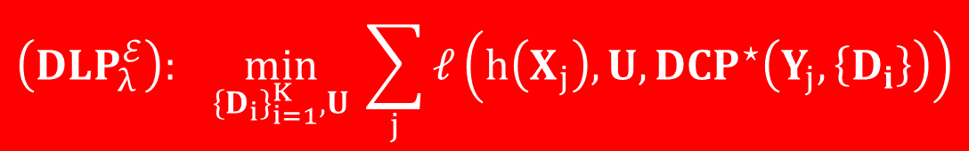
Deep Coding and Learning Problems
$\left(DCP_{λ}^{ℰ}\right):$ Find a set of representations satisfying
$$\begin{matrix}{\left\|Y−D_{1}Γ_{1}\right\|}_{2}≤ℰ_{0} & {\left\|Γ_{1}\right\|}_{0,∞}^{s}≤λ_{1} \\ {\left\|Γ_{1}−D_{2}Γ_{2}\right\|}_{2}≤ℰ_{1} & {\left\|Γ_{2}\right\|}_{0,∞}^{s}≤λ_{2} \\ ⋮ & ⋮ \\ {\left\|Γ_{K−1}−D_{K}Γ_{K}\right\|}_{2}≤ℰ_{K−1} & {\left\|Γ_{K}\right\|}_{0,∞}^{s}≤λ_{K}\end{matrix}$$
$$\left(DLP_{λ}^{ℰ}\right): \min_{{\left\{D_{i}\right\}}_{i=1}^{K},U}{ \sum_{j}{ℓ\left(h\left(X_{j}\right),U,{DCP}^{⋆}\left(Y_{j},\left\{D_{i}\right\}\right)\right)}}$$
True label
Classifier
Deepest representation obtained by solving the DCP

Slide 40

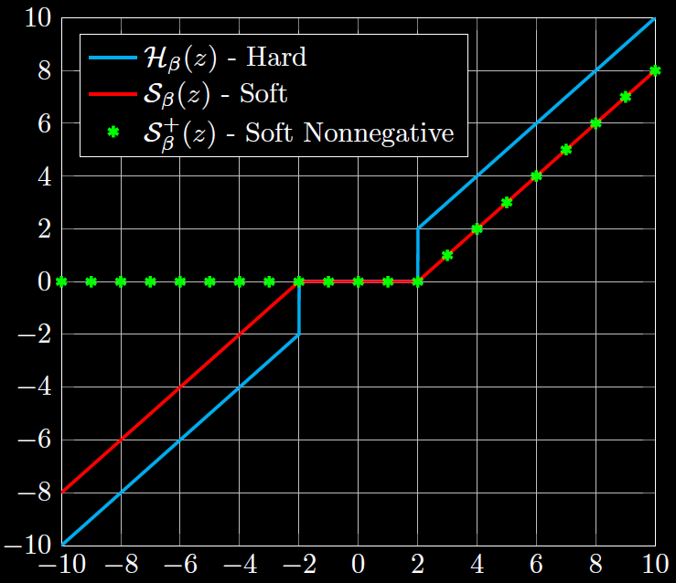



The simplest pursuit in the sparse representation is the thresholding algorithm. Given an input signal $X$, this operates by:
$$D^{T}X$$
$$𝒫_{β}\left(D^{T}X\right)$$
Restricting the coefficients to be nonnegative does not restrict the expressiveness of the model
ReLU = Soft
Nonnegative Thresholding
[Fawzi, Davies &
Frossard ‘15]

Slide 41
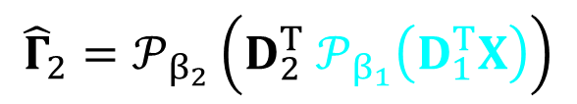
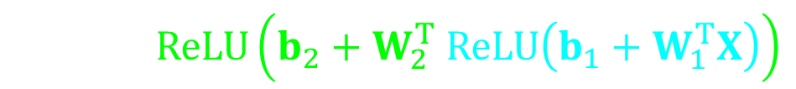
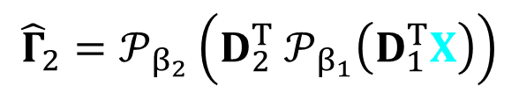




Consider this for Solving the DCP
$\left(DCP_{λ}\right):$ Find a set of representations satisfying
$$\begin{matrix}X=D_{1}Γ_{1} & {\left\|Γ_{1}\right\|}_{0,∞}^{s}≤λ_{1} \\ Γ_{1}=D_{2}Γ_{2} & {\left\|Γ_{2}\right\|}_{0,∞}^{s}≤λ_{2} \\ ⋮ & ⋮ \\ Γ_{K−1}=D_{K}Γ_{K} & {\left\|Γ_{K}\right\|}_{0,∞}^{s}≤λ_{K}\end{matrix}$$
Layered thresholding (LT):
Forward pass of CNN:
Estimate $Γ_{1}$ via the thresholding algorithm
$${\hat{Γ}}_{2}=𝒫_{β_{2}}\left(D_{2}^{T} 𝒫_{β_{1}}\left(D_{1}^{T}X\right)\right)$$
$${\hat{Γ}}_{2}=𝒫_{β_{2}}\left(D_{2}^{T} 𝒫_{β_{1}}\left(D_{1}^{T}X\right)\right)$$
$${\hat{Γ}}_{2}=𝒫_{β_{2}}\left(D_{2}^{T} 𝒫_{β_{1}}\left(D_{1}^{T}X\right)\right)$$
Estimate $Γ_{2}$ via the thresholding algorithm
$$f\left(X\right)=ReLU\left(b_{2}+W_{2}^{T} ReLU\left(b_{1}+W_{1}^{T}X\right)\right)$$
The layered (soft nonnegative) thresholding and the forward pass algorithm are equal !!!

Slide 42


Consider this for Solving the DLP
DLP:
$$\min_{{\left\{D_{i}\right\}}_{i=1}^{K},U}{ \sum_{j}{ℓ\left(h\left(X_{j}\right),U,{DCP}^{⋆}\left(X_{j},\left\{D_{i}\right\}\right)\right)}}$$
CNN training:
$$\min_{\left\{W_{i}\right\},\left\{b_{i}\right\},U}{\sum_{j}{ℓ\left(h\left(X_{j}\right),U,f\left(X,\left\{W_{i}\right\},\left\{b_{i}\right\}\right)\right)}}$$
$$\min_{{\left\{D_{i}\right\}}_{i=1}^{K},U}{ \sum_{j}{ℓ\left(h\left(X_{j}\right),U,{DCP}^{⋆}\left(X_{j},\left\{D_{i}\right\}\right)\right)}}$$
Estimate via the layered thresholding algorithm
The problem solved by the training stage of CNN and the DLP are equal assuming that the DCP is approximated via the layered thresholding algorithm

Slide 43






Theoretical Questions
M
A
$${\left\{{\hat{Γ}}_{i}\right\}}_{i=1}^{K}$$
$$X=D_{1}Γ_{1}$$
$$Γ_{1}=D_{2}Γ_{2}$$
$$⋮$$
$$Γ_{K−1}=D_{K}Γ_{K}$$
$Γ_{i}$ is $L_{0,∞}$ sparse
$$\left(DCP_{λ}^{ℰ}\right)$$
Layered Thresholding
(Forward Pass)
Other?
$$X$$
$$Y$$

Slide 44




Uniqueness of $\left(DCP_{λ}\right)$
$\left(DCP_{λ}\right):$ Find a set of representations satisfying
$$\begin{matrix}X=D_{1}Γ_{1} & {\left\|Γ_{1}\right\|}_{0,∞}^{s}≤λ_{1} \\ Γ_{1}=D_{2}Γ_{2} & {\left\|Γ_{2}\right\|}_{0,∞}^{s}≤λ_{2} \\ ⋮ & ⋮ \\ Γ_{K−1}=D_{K}Γ_{K} & {\left\|Γ_{K}\right\|}_{0,∞}^{s}≤λ_{K}\end{matrix}$$
Is this set unique?
Theorem: If a set of solutions ${\left\{Γ_{i}\right\}}_{i=1}^{K}$ is found for $({DCP}_{λ})$ such that:
$${\left\|Γ_{i}\right\|}_{0,∞}^{s}≤λ_{i}<\frac{1}{2}\left(1+\frac{1}{μ\left(D_{i}\right)}\right)$$
Then these are necessarily the unique solution to this problem.
The feature maps CNN aims to recover are unique
[Papyan, Sulam & Elad ‘16]

Slide 45


Stability of $\left(DCP_{λ}^{ℰ}\right)$
Theorem: If the true representations ${\left\{Γ_{i}\right\}}_{i=1}^{K}$ satisfy
$${\left\|Γ_{i}\right\|}_{0,∞}^{s}≤λ_{i}<\frac{1}{2}\left(1+\frac{1}{μ\left(D_{i}\right)}\right)$$
And the error thresholds for $({DCP}_{λ}^{ℰ})$ are
$$ℰ_{0}^{2}={\left\|E\right\|}_{2}^{2}, ℰ_{i}^{2}=\frac{4ℰ_{i−1}^{2}}{1−\left(2{\left\|Γ_{i}\right\|}_{0,∞}^{s}−1\right)μ\left(D_{i}\right)}$$
Then the set of solutions ${\left\{{\hat{Γ}}_{i}\right\}}_{i=1}^{K}$ obtained by solving this problem must be close to the true ones
$${\left\|{\hat{Γ}}_{i}−Γ_{i}\right\|}_{2}^{2}≤ℰ_{i}^{2}$$
The problem CNN aims to solve is stable under certain conditions
[Papyan, Sulam & Elad ‘16]

Slide 46

Stability of LT
Theorem: If ${\left\|Γ_{i}\right\|}_{0,∞}^{s}<\frac{1}{2}\left(1+\frac{1}{μ\left(D_{i}\right)}⋅\frac{\left|Γ_{ i}^{min}\right|}{\left|Γ_{ i}^{max}\right|}\right)−\frac{1}{μ\left(D_{i}\right)}⋅\frac{ε_{L}^{i−1}}{\left|Γ_{ i}^{max}\right|}$
Then the layered hard thresholding will*
Find the correct supports
${\left\|Γ_{ i}^{LT}−Γ_{i}\right\|}_{2,∞}^{p}≤ε_{L}^{i}$
We have defined $ε_{L}^{0}={\left\|E\right\|}_{2,∞}^{p}$ and
$$ε_{L}^{i}=\sqrt{{\left\|Γ_{i}\right\|}_{0,∞}^{p}}⋅\left(ε_{L}^{i−1}+μ\left(D_{i}\right)\left({\left\|Γ_{i}\right\|}_{0,∞}^{s}−1\right)\left|Γ_{ i}^{max}\right|{+ β}_{i}\right)$$
soft
The stability of the forward pass is guaranteed if the underlying representations are locally sparse and the noise is locally bounded
* For correctly chosen thresholds

Slide 47

Limitations of the Forward Pass
The stability analysis reveals several inherent limitations of the forward pass algorithm:
  Even in the noiseless case, it is incapable of recovering the solution of the DCP problem.
  Its success depends on the ratio $\left|Γ_{ i}^{min}\right|/\left|Γ_{ i}^{max}\right|$. This is a direct consequence of the forward pass algorithm relying on the simple thresholding operator.
  The distance between the true sparse vector and the estimated one increases exponentially as function of the layer depth.
In the next and final part we propose a new algorithm attempting to solve some of these problems.

Slide 48
What Next?
Part IV
Convolutional Neural Networks Analyzed via
Convolutional Sparse Coding
Vardan Papyan, Yaniv Romano and Michael Elad

Slide 49




Layered Basis Pursuit (Noiseless)
$\left(DCP_{λ}\right):$ Find a set of representations satisfying
$$\begin{matrix}X=D_{1}Γ_{1} & {\left\|Γ_{1}\right\|}_{0,∞}^{s}≤λ_{1} \\ Γ_{1}=D_{2}Γ_{2} & {\left\|Γ_{2}\right\|}_{0,∞}^{s}≤λ_{2} \\ ⋮ & ⋮ \\ Γ_{K−1}=D_{K}Γ_{K} & {\left\|Γ_{K}\right\|}_{0,∞}^{s}≤λ_{K}\end{matrix}$$
Our Goal:
Layered thresholding: ${\hat{Γ}}_{2}=𝒫_{β_{2}}\left(D_{2}^{T} 𝒫_{β_{1}}\left(D_{1}^{T}X\right)\right)$
Thresholding is the simplest pursuit known in the field of sparsity.
Layered BP:
$$Γ_{1}^{LBP}=\min_{Γ_{1}}{ {\left\|Γ_{1}\right\|}_{1} s.t. X=D_{1}Γ_{1}}$$
Deconvolutional networks
[Zeiler, Krishnan, Taylor & Fergus ‘10]
$$Γ_{2}^{LBP}=\min_{Γ_{2}}{ {\left\|Γ_{2}\right\|}_{1} s.t. Γ_{1}^{LBP}=D_{2}Γ_{2}}$$

Slide 50


Guarantee for Success of Layered BP
$\left(DCP_{λ}\right):$ Find a set of representations satisfying
$$\begin{matrix}X=D_{1}Γ_{1} & {\left\|Γ_{1}\right\|}_{0,∞}^{s}≤λ_{1} \\ Γ_{1}=D_{2}Γ_{2} & {\left\|Γ_{2}\right\|}_{0,∞}^{s}≤λ_{2} \\ ⋮ & ⋮ \\ Γ_{K−1}=D_{K}Γ_{K} & {\left\|Γ_{K}\right\|}_{0,∞}^{s}≤λ_{K}\end{matrix}$$
Our Goal:
The layered BP can retrieve the underlying representations in the noiseless case, a task in which the forward pass fails.
Its success does not depend on the ratio $\left|Γ_{ i}^{min}\right|/\left|Γ_{ i}^{max}\right|$.
Theorem: If a set of solutions ${\left\{Γ_{i}\right\}}_{i=1}^{K}$ of $(DCP_{λ})$ satisfy
$${\left\|Γ_{i}\right\|}_{0,∞}^{s}≤λ_{i}<\frac{1}{2}\left(1+\frac{1}{μ\left(D_{i}\right)}\right)$$
Then the layered BP is guaranteed to find them.
[Papyan, Sulam & Elad ‘16]

Slide 51


Stability of Layered BP
Theorem: Assuming that
$${\left\|Γ_{i}\right\|}_{0,∞}^{s}<\frac{1}{3}\left(1+\frac{1}{μ\left(D_{i}\right)}\right)$$
Then we are guaranteed that*
The support of $Γ_{ i}^{LBP}$ is contained in that of $Γ_{i}$
${\left\|Γ_{ i}^{LBP}−Γ_{i}\right\|}_{2,∞}≤ε_{L}^{i}$
Every entry in $Γ_{i}$ greater than $ε_{L}^{i}/\sqrt{{\left\|Γ_{i}\right\|}_{0,∞}^{p}}$will be found
$$ε_{L}^{i}={7.5}^{i}{\left\|E\right\|}_{2,∞} \prod_{j=1}^{i}{\sqrt{{\left\|Γ_{j}\right\|}_{0,∞}^{p}}}$$
* For correctly chosen ${\left\{ξ_{i}\right\}}_{i=1}^{K}$
[Papyan, Sulam & Elad ‘16]

Slide 52





Layered Iterative Thresholding
Layered
BP
$$Γ_{1}^{LBP}=\min_{Γ_{1}}{ \frac{1}{2}{\left\|Y−D_{1}Γ_{1}\right\|}_{2}^{2}+ξ_{1}{\left\|Γ_{1}\right\|}_{1}}$$
$$Γ_{2}^{LBP}=\min_{Γ_{2}}{ \frac{1}{2}{ \left\|Γ_{1}^{LBP}−D_{2}Γ_{2}\right\|}_{2}^{2}+ξ_{2}{\left\|Γ_{2}\right\|}_{1}}$$
Can be seen as a recurrent neural network
[Gregor & LeCun ‘10]
Layered
IT
$$Γ_{1}^{t}=𝒮_{ξ_{1}/c_{1}}\left(Γ_{1}^{t−1}+\frac{1}{c_{1}}D_{1}^{T}\left(Y−D_{1}Γ_{1}^{t−1}\right)\right)$$
$$Γ_{2}^{t}=𝒮_{ξ_{2}/c_{2}}\left(Γ_{2}^{t−1}+\frac{1}{c_{2}}D_{2}^{T}\left({\hat{Γ}}_{1}−D_{2}Γ_{2}^{t−1}\right)\right)$$
* $c_{i}>0.5 λ_{max}(D_{i}^{T}D_{i})$

Slide 53


Conclusion
We described the limitations of patch based processing as a motivation for the CSC model.
We then presented a theoretical study of this model both in a noiseless and a noisy setting.
A multi-layer extension for it, tightly connected to CNN, was proposed and similarly analyzed.
Finally, an alternative to the forward pass algorithm was presented.
Future Work: leveraging theoretical insights
into practical implications

Slide 54

Questions?

